Slide 1
How to Reset Oracle EBS Password

Slide 2
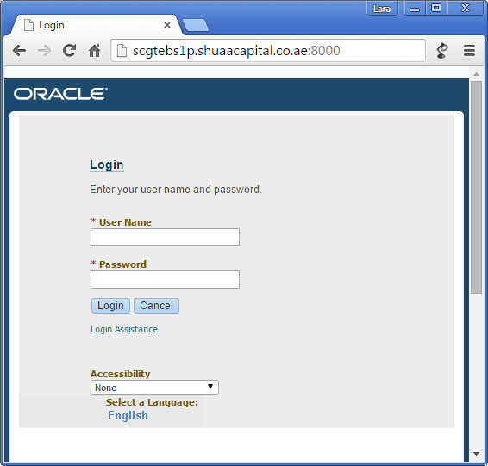
Click on Login Assistance

Slide 3
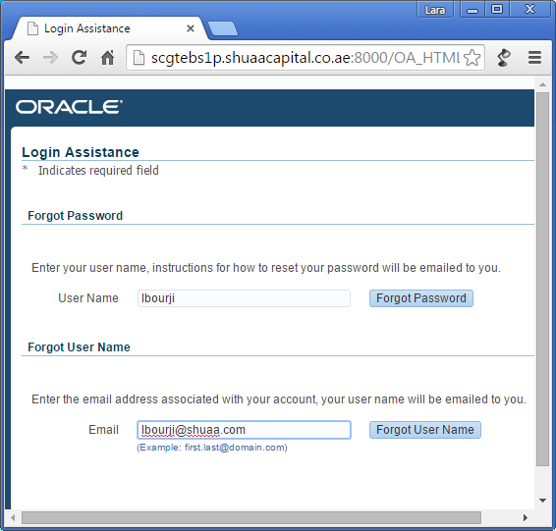
Enter your User Name (same as your network login) and click Forgot Password Or enter your Email and click Forgot User Name

Slide 4
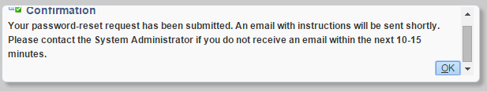
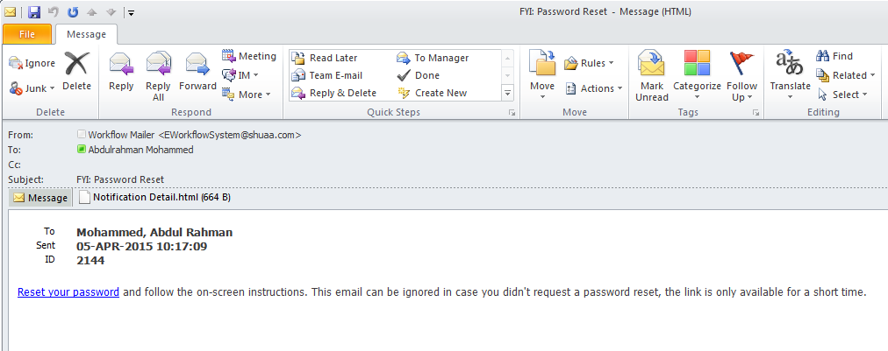
A popup will confirm your password reset request, and you will receive an email within 15mins with a link to reset your password.

